Slide 1



CubeSat Reaction Wheel Attitude Control Platform
Justin Hartland, Dylan Ballback, Dan Wilczak,
Ella Cheatham, Stanlie Cerda-Cruz, Vishwam Rathod,
Ryan Taylor, Isaac Stitt, Jacob Romeo
See it!
See it!
See it!
See it!
See it!
App Design: bit.ly/3sDujQC
App Design: URL to design pdf
App Design: URL to design pdf
App Design: bit.ly/3sDujQC
App Design: URL to design pdf
Hardware Dev: bit.ly/3GHhKbJ
Hardware Dev: URL to Github
Hardware Dev: URL to Github
Hardware Dev: bit.ly/3GHhKbJ
App Design: bit.ly/34qawvR
Hardware Dev: URL to Github
Demo: bit.ly/3HW2RmB
Survey: bit.ly/3hNF5yn

Slide 2
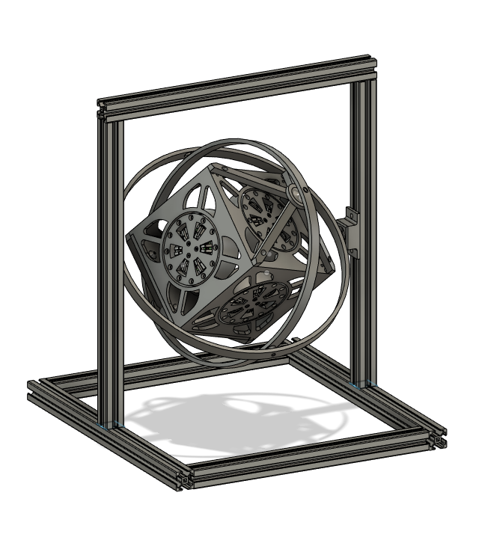
Overall Goals
Develop 1U, 3U, and 6U CubeSat Reaction Wheel Attitude Control Platform
Integrate CubeSat control into a website to allow anyone to upload their own control algorithm and watch a live stream to evaluate how it performs
Include spacecraft controls tutorial in website to guide students

Slide 3
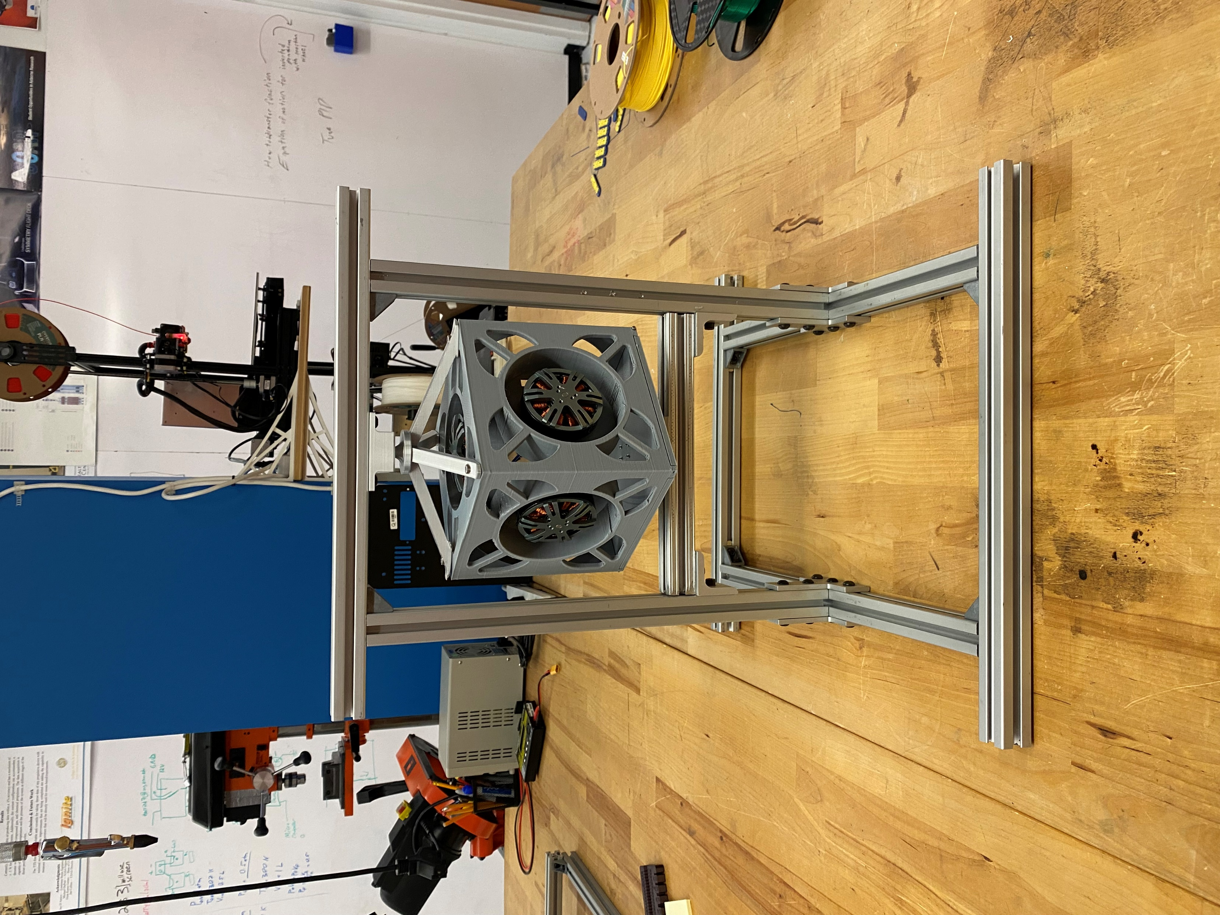
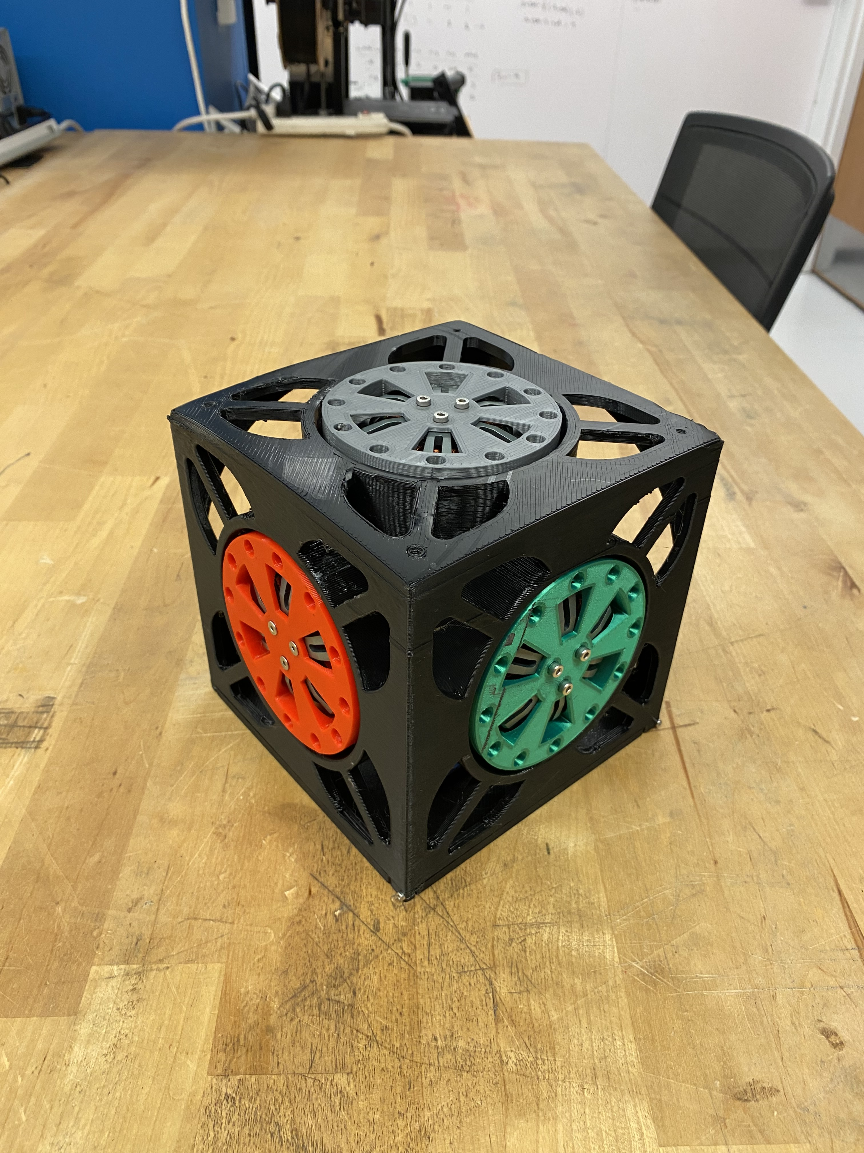
Current State
Initial CubeSat design is complete with three reaction wheels fully implemented
Beginning process of designing rings for 2 and 3 degrees of freedom
Researching PID control systems using an inverted pendulum

